Slide 1

Cocktail Ingredients Data Pipeline
Team 2: Marvin Moran, Muris Saab, Ravita Kartawinata
Notes:
Hello everyone and welcome to our ADS507, final project presentation! My name is Muris and along with my colleagues Marvin and Ravi are team number 2.
Over the next 10 mins we want to give you an overview of the Cocktail Ingredients data pipeline.

Slide 2
Project Objectives
01
Pipeline
Build data pipeline for drink elements.
2 sources.
02
Catalog
Present a catalog user interface for search.
03
Visuals
Present visuals for category & country of original based on catalog search.
Notes:
We chose to build a data pipeline that takes as input distinct sources of data and produces a table that can be used as a catalog of alcoholic and non-alcoholic cocktails.
The pipeline output can then be used by users to search for specific cocktail ingredients based on categories, glass types and other classifiers can assist with the search.
Next, Ravi will further explore the details about the data and how the pipeline works.

Slide 3
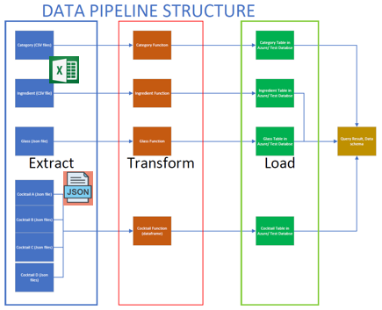

Data Source and Extraction
Sources:
2 CSV files of Category and Ingredient
2 API files of Glass and drinks
Establish Connection to cocktaildb.com API
Extract data
https://github.com/Pii-USD/ADS507
Extract Transform Load (ETL) architect diagram
Notes:
Thank you Muris. Hi Everyone, my name is Ravita
In the next 3 mins, I am going to share how data are ingested, extracted from sources, manipulated and changed according to our objective. At the end, these data will be stored in Azure platform SQL Database .
There are 4 datasets for this project; 2 CSV files and 2 JSON files. These are originated from cocktaildb.com.
Category and Ingredients contain of structured data and formatted in CSV files. Since it’s structured well, it doesn’t require changes, these data were extracted in batch.
While Glass Type and Drink dataset are formatted in JSON file and were extracted by establishing a connection for API integration.

Slide 4
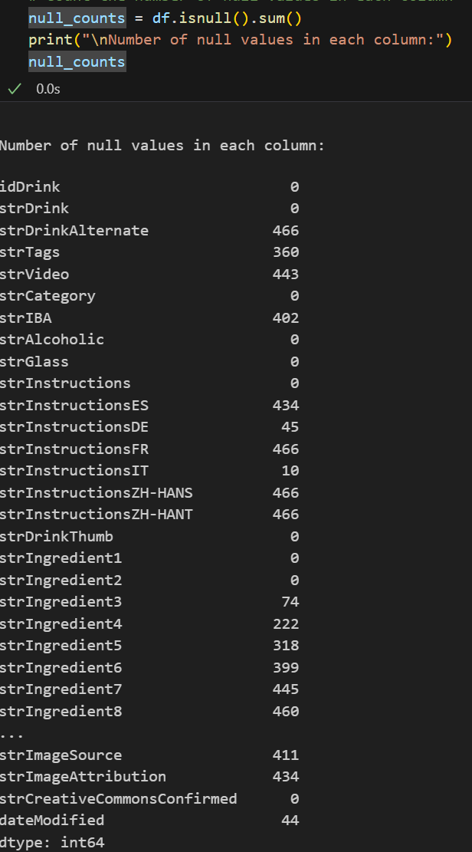
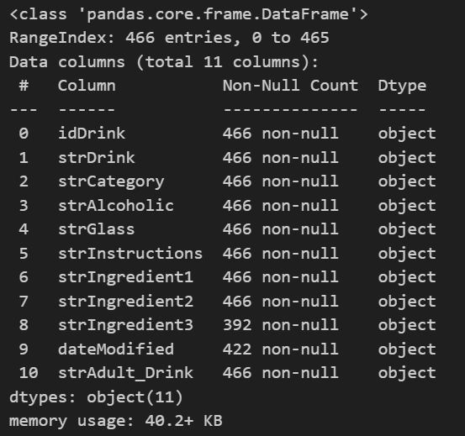
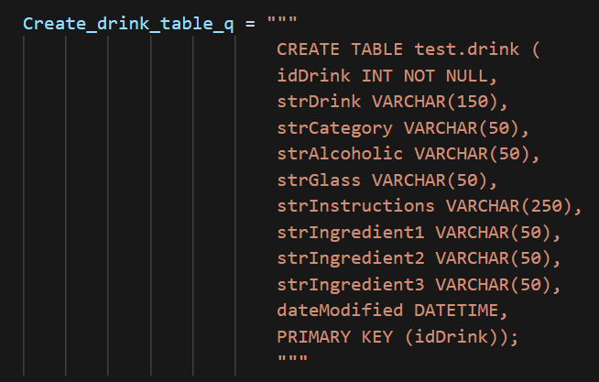
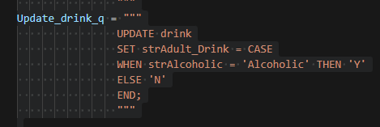
Data Clean up and Transformation
Data Clean up
Columns with Null Values
Drop columns with null values
Drink table attributes to be loaded to SQL DB →
Perform data transformation in SQL
Notes:
We reviewed these 4 datasets and found that Category, Ingredient and Glass Type don’t need any transformation.
While Drink dataframe, we found some nulls values. These null values in these columns are not significant to the data and project objective. Therefore, these columns will be dropped from dataframe before it’s stored.
Category, Ingredient, Glass Type and cleaned-up Drink datasets were loaded to SQL database in Azure platform.
A simple transformation was also done in SQL by adding new binary column in Drink Table to identify if it’s adult drink or not. strAdult_Drink attribute in Drink table was updated by cooperating Case Statement.

Slide 5
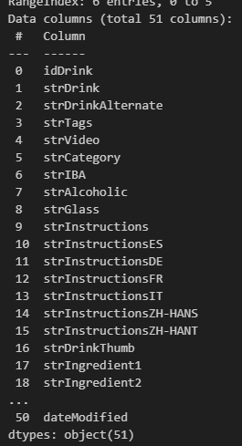
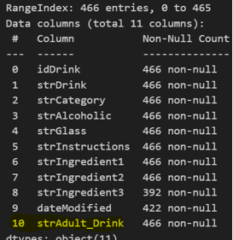
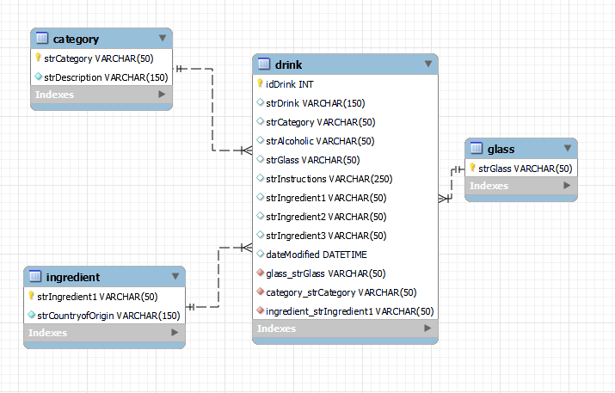
Data Load and Schema
Extracted Dataset
Transformed Dataset
Loaded Datasets – Database Schema
Notes:
After data was cleaned and transformed, we connected to our database to send the transformed data for storage. A database model/ schema was generated by utilizing reverse engineering. The loaded dataset in SQL DB would be use in the future to meet the business purpose.
Marvin will elaborate how the data will be interacted .

Slide 6
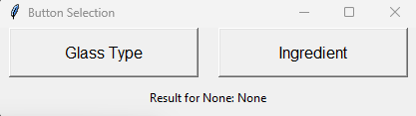
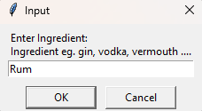
Graphical Interface Function
Pipeline Data
1
Leverage static table from data pipeline.
User Input
User input triggers front end search result and backend query.
Results
Query results present query results.
2

Slide 7
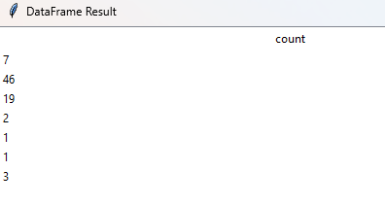
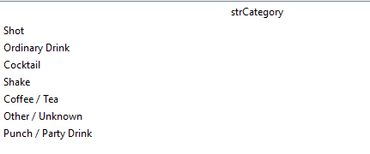
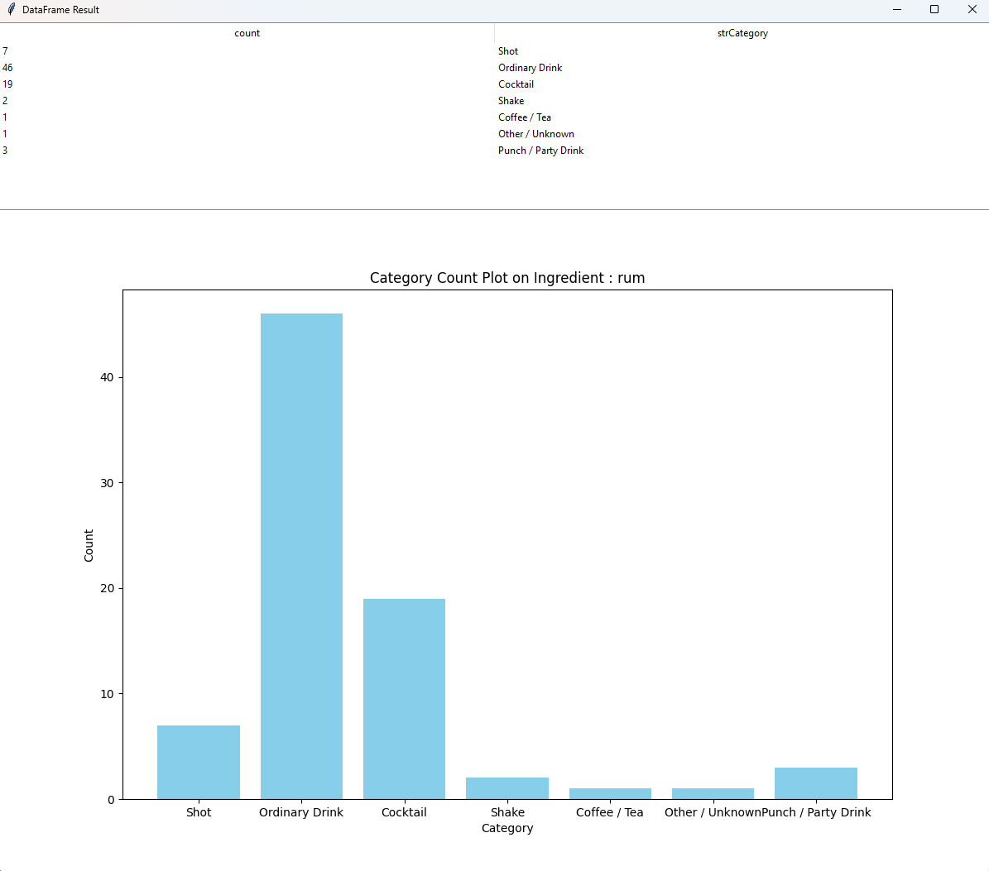
Graphical Interface Results
Caterogry
Resulting categories for drinks with target ingredient.
Count
Count of categories.

Slide 8
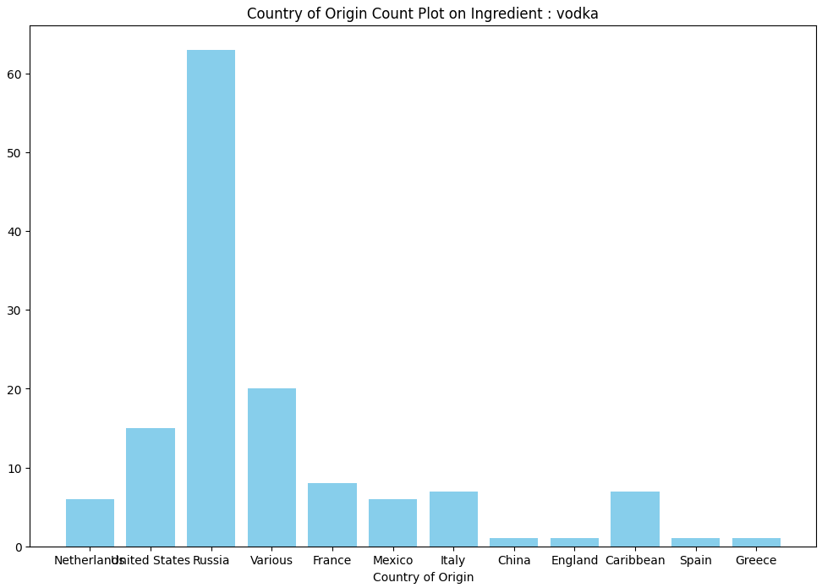
Supporting Visual
Origin
Visual for country of origin.

Slide 9
Recap Summary
01
Pipeline
Build data pipeline for drink elements.
2 sources.
02
Catalog
Present a catalog user interface for search.
03
Visuals
Present visuals for category & country of original based on catalog search.

Slide 10
References
Reis, J., & Housley, M. L. (2023b). Fundamentals of Data Engineering. Dong nan da xue chuban she.
Chapter 13 Data types, Chapter 15 SQL statements. MySQL. (n.d.).
https://dev.mysql.com/doc/refman/8.0/en

